Slide 1


BANKING PLATFORM
Transactions Analysis
By Roy Nabulwe, Data Analyst
Designation: Managing Director

Slide 2




Problem Summary
•Irregular transaction success rates reduce system reliability.
•High latency spikes across network slices affect user experience.
•Significant number of fraud cases detected in the dataset.
•Transaction failures impact customer trust and service efficiency.

Slide 3

Objectives of the Analysis
•Evaluate transaction performance across the system.
•Identify patterns in transaction success and failure.
•Assess latency across different network slices.
•Detect fraud prevalence and operational risks.

Slide 4

Dataset Overview
•1 dataset analyzed (40,000 records).
•Key columns: Transaction Amount, Type, Status, Latency, Fraud Flag, Network Slice.
•Cleaning: Removing duplicates, standardized column formats, split columns using power query.

Slide 5

Key Metrics(KPI)
•Total Transactions: 40,000
•Total Amount Processed: $99,812,984.44
•Average Latency: 76.75 ms
•Success Rate: 80.08%
•Fraud Cases Detected: 707

Slide 6

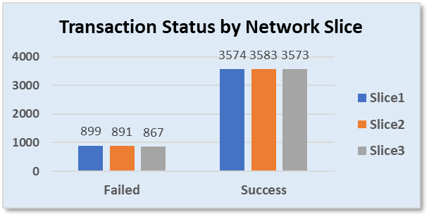
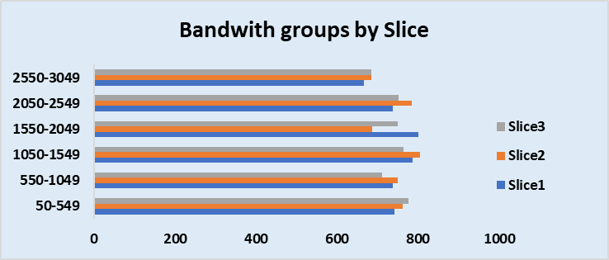
Dashboard Insights:
There's no significant finding showing correlation between network slice and transaction success/failure rate.
There is no pattern suggesting that higher network slices have higher bandwiths.

Slide 7
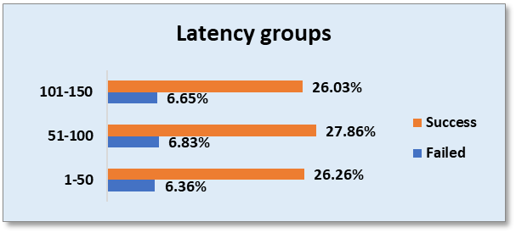
Dashboard Insights:
Higher latency groups recorded higher transaction failure rates.
Majority of the clients are in the higher latency groups.

Slide 8

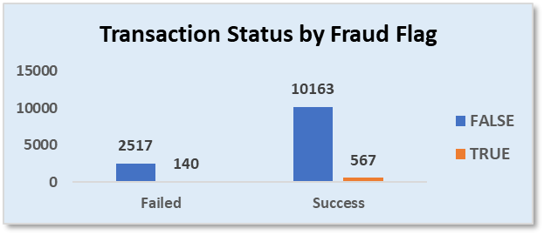
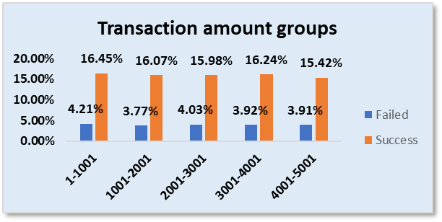
Dashboard Insights:
Majority of fraud flagged transactions still succeed(567), while only a few get blocked(140).
There is no strong evidence of correlation between transaction amount and success or failure rates, the distribution among the groups is random.

Slide 9

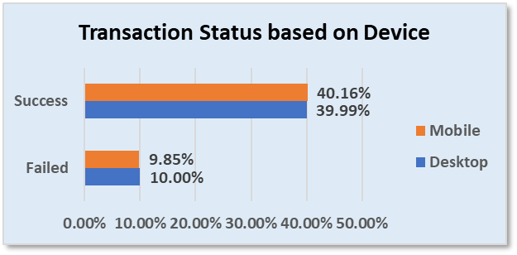
Dashboard Insights:
Higher transaction failure rates on the desktop platform as compared to mobile users(Desktop: 10% | Mobile: 9.85%).

Slide 10

Summary of Findings
Success rate is below optimal for stable fintech operations.
Fraud is being detected but the transactions are not being blocked.
Latency fluctuations impact transaction completion. Higher latency is associated with higher failure rates.
The 5G Network slicing is not proving to be a worthwhile investment, users with higher network slices(Slice 1 and 2) higher transaction failure rates.
The Desktop portal seems to have more failure rates as compared to the mobile app therefore the app development resources should be focused on it.

Slide 11

Recommendations
Strengthen fraud‑detection algorithms and early warning systems.
Optimize network slice load balancing to reduce latency.
Improve backend transaction retry mechanisms.
Implement continuous monitoring dashboards for real‑time alerts.
Focus App Development resources towards the Desktop portal next quarter.

Slide 12

Conclusion
•Thank you to the board for reviewing this analysis.
•The findings provide clarity on system performance gaps.
•With this analysis, we now understand where the digital payment system loses, efficiency and how to improve it.
-
leeroynabulwe@gmail.com

